Slide 1

OLIST STORE ANALYSIS

Slide 2
CONTENTS
Introduction
Dashboard
Insights & kpis
Areas Of Focus
Suggestion

Slide 3
Group Members
Kunal Manwar
Nabeeha Nausheen
Mrunmayai Linge
Swathi K
Sahil Shelar
Priya Samaddar

Slide 4
INTRODUCTION
By analyzing this dataset, we aim to understand the performance of the Olist store, identify trends and extract valuable insights to drive business growth and improve overall efficiency.
The project will involve exploring different aspects of the e-commerce domain, such as customer behavior, sales patterns, product popularity, seller performance and more..
Through this Olist Store Analysis project, we hope to uncover valuable insight that can contribute to better decision making, Operational efficiency, Customer Satisfaction.
The finding could potentially guide marketing strategies, inventory management, Sellers onboarding & other crucial aspect of the ecommerce business.

Slide 5
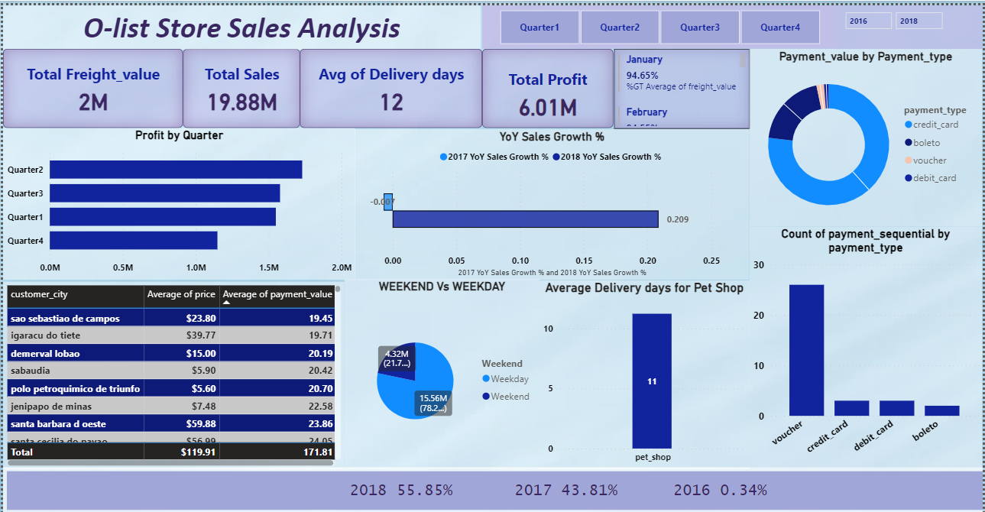


INTRODUCTION
Olist Sales Analysis Dashboard
At Krypto Logics, we empower investors to maximize their portfolios to help them meet their financial goals responsibly. By offering customized and sophisticated strategies, we help clients' portfolios grow organically and foster a trusted consumer-consultant relationship.

Slide 6
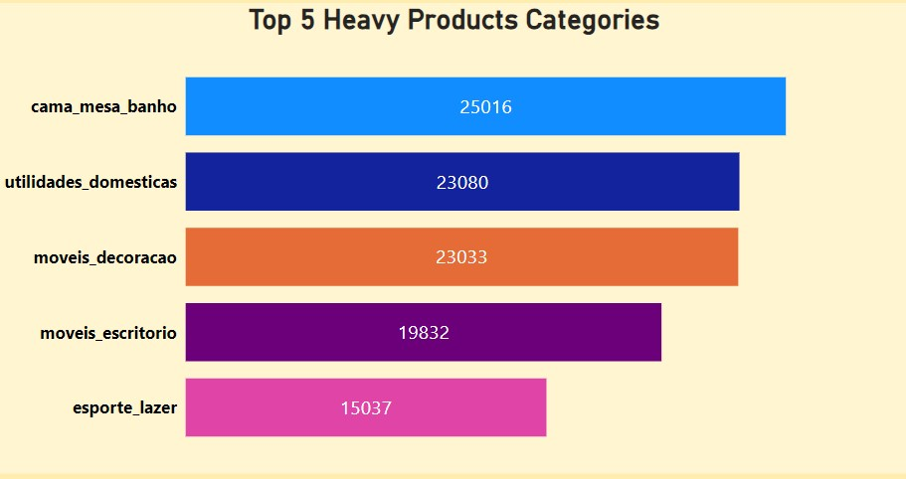
KPI-1 TOP 5 HEAVY PRODUCT CATEGORIES
The heaviest product category among all the product categories was Cama_Mesa_Banho.
Then comes the Utilidades_Domesticas which gets the second position for being heavier.
As the weight of the Product Categories increases the Shipping cost increases.
Also heavier products may require longer delivery times due to logistical challenges associated with handling and transportation.
Heavier products may require stronger and more durable packaging materials to ensure product integrity during transit.

Slide 7
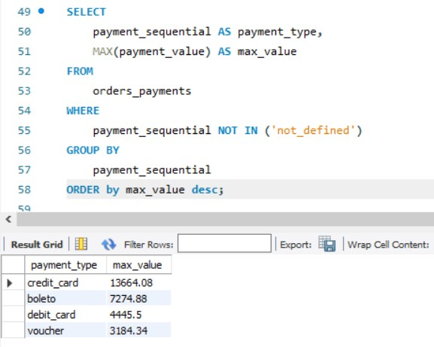
Kpi–2 Max Payment by payment type
Understanding the KPI
Using Group By
Using Order By to get Max value by desc order.

Slide 8
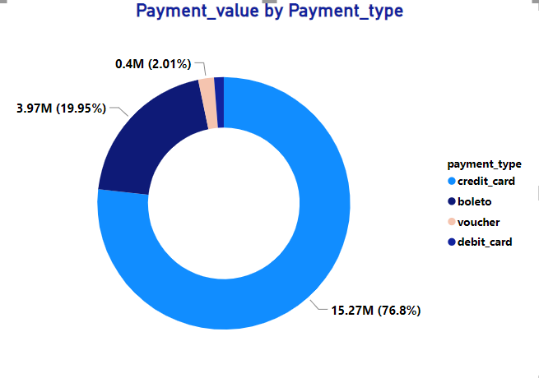
KPI-3 PAYMENT VALUE BY PAYMENT TYPE
We have plotted customer payment database and no of orders on Pie chart to check which payment mode is preferred by customer. From pie chart, it is reported that total four type of payment methods are used by customers i.e., credit card, Boleto, debit card and voucher.
Out of all orders, 76.8% of orders have reported credit card as payment mode & 19.95% orders reported as Boleto payment mode which contribute 95% of total payment records. We can conclude that Olist should use credit card promotional schemes to increase orders in upcoming years.
Optimizing payment processing systems to accommodate preferred payment methods can enhance customer satisfaction and increase conversion rates.
Offering incentives or discounts for certain payment types can encourage customers to use preferred methods, potentially reducing processing fees.
Conclusion: Analyzing payment value by payment type provides valuable insights for understanding customer behavior and optimizing business operations.

Slide 9
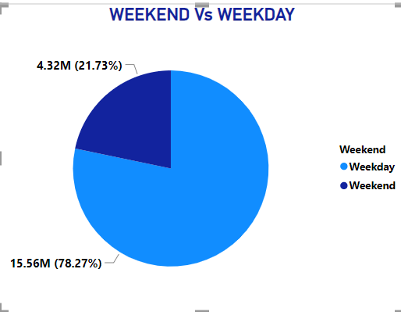
KPI-4 WEEKEND VS WEEKDAY
Higher customer engagement and increased order activity on weekday as compared to weekend could be due to customers having more free time, relaxed schedules, and the opportunity to browse and make purchases at their leisure.
Weekdays may exhibit more consistent order activity, reflecting routine shopping behaviors and consistent demand throughout the workweek. This could be influenced by factors such as work schedules, limited time availability, and a focus on essential purchases.
Marketing Opportunities: Promotions, discounts, and advertising campaigns can be strategically planned and tailored to maximize customer engagement and drive sales during specific days of the week.
Customer Segmentation: Analyzing weekdays versus weekends enables customer segmentation on allowing for personalized marketing approaches to reach customers effectively on the days when they are more likely to make purchases.

Slide 10
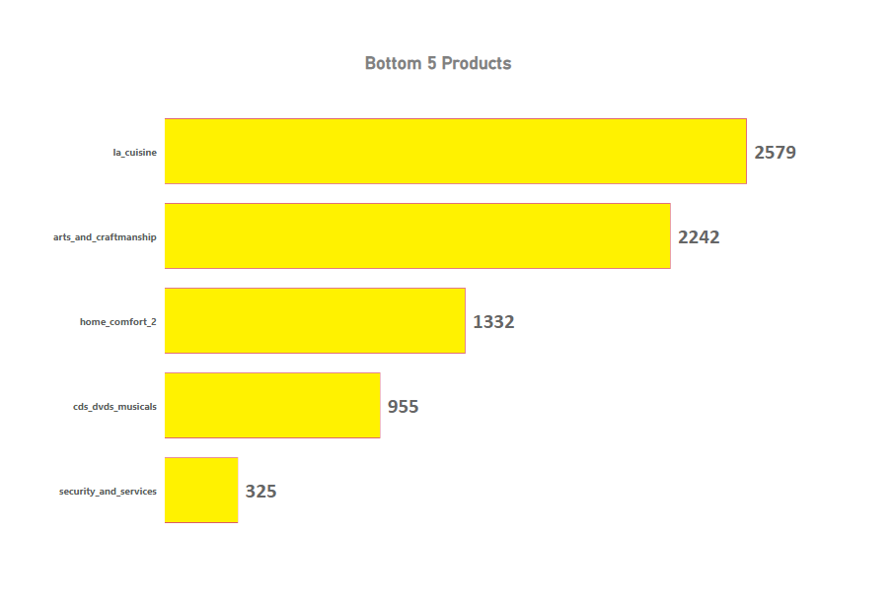
KPI-5 BOTTOM 5 PRODUCTS
This graph display the bottom 5 products.
The length of each bar represents the number of products within that specific category.
Dominant Category: It appears that the "la_cuisine" category has the highest number of products.
Other Significant Categories: The categories "arts_and_craftmanship" and "home_comfort_2" also seem to have a substantial number of products.
Lowest Counts: "cds_dvds_musicals" and "security_and_services" have the fewest products compared to the other categories.
Conclusion: the bottom 5 products on Olist represent areas of concern that require attention and strategic intervention. By analyzing the underlying factors contributing to their underperformance and implementing targeted strategies for improvement, Olist can enhance its product portfolio and strengthen its competitive position in the market.

Slide 11
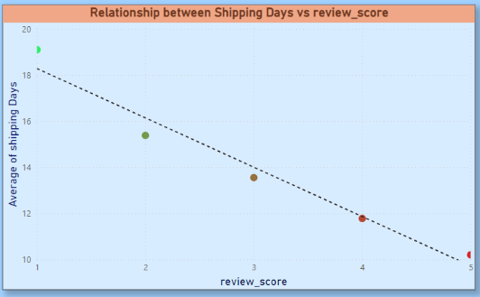
Kpi-6 shipping days vs review score
A Negative Correlation implies that as shipping days increase , review scores tend to decrease.
Some Categories May experience longer shipping times and higher freight value compared to others. This can be attributed to various factors such as product size , fragility, or special handling requirements
Product under review score 5 indicates that certain categories may have stronger correlation between product quality customer satisfaction and resulting review scores.
It helps in understanding the impact of delivery time on customer satisfaction levels. Olist can use this information to optimize their logistics and improve their delivery time.
Conclusion: It suggest’s that longer shipping durations are associated with lower customer satisfaction, as reflected in the review scores. Analyzing the relationship between product categories and review scores provides insights for identifying areas of improvement. This includes addressing any quality issues , optimizing customer service for specific categories, and enhancing the overall shopping experience each category.

Slide 12
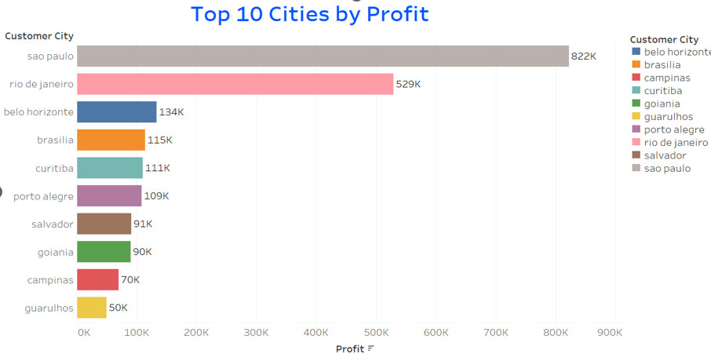
KPI-7 TOP 10 CITIES BY PROFIT
The top 10 cities likely represent significant market potential for Olist. Analyzing their performance can provide insights into where the company's products or services are most in demand.
São Paulo, Rio de Janeiro, and Belo Horizonte are the top three cities by profit points.
There is a significant gap in profit points between the top-performing cities and the rest.
Conclusion: By understanding the significance of the top 10 cities by profit points, Olist can develop informed strategies to capitalize on opportunities, mitigate risks, and drive sustainable growth and profitability.

Slide 13
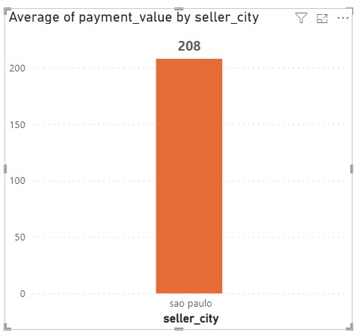
KPI 8- Average payment value by Seller City
The higher average price and payment values in Sao Paulo City imply that the customer base in this city may have a higher income level or overall purchasing capacity.
By understanding the preferences and behaviors of customers from Sao Paulo, the Olist Store can tailor marketing strategies and product offerings to better serve this specific segment.
This conclusion suggests to offer competitive prices that align with customer expectations and market conditions in each location.
Identify areas where the Olist Store can differentiate itself by offering competitive prices or providing additional value to customers. This analysis can help to optimize pricing strategies and stay ahead in the market. Emphasize quality, unique features, or superior customer service to justify the higher prices and enhance customer satisfaction.

Slide 14
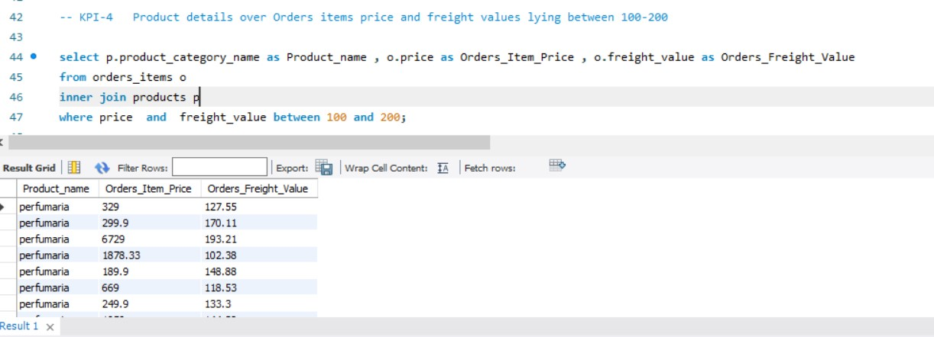
Kpi–9 Product details between over order items and freight values between 100-200
Understanding the KPI
Using Inner Join
Using Where Clause and Between to get the Freight Value

Slide 15
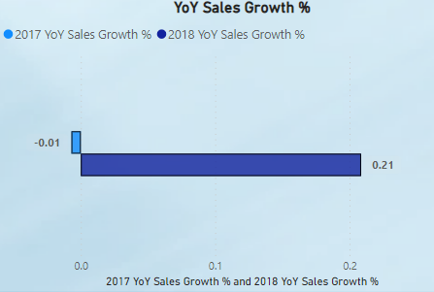
KPI-10 YOY SALES GROWTH%
The positive YoY sales growth percentage is generally seen as a favorable indicator of business performance. It implies that Olist stores are effectively capturing market share or expanding their customer base, which is crucial for sustainable business growth and competitiveness in the retail sector.
The conclusion for the year-over-year (YoY) sales growth percentage of Olist stores indicates a positive trend. A YoY growth rate of 2017 –was approximately -0.1% which suggests that Olist stores experienced no sales expansion from the previous year 2016 to 2017. A YoY growth rate of 2018 was approximately 0.21% which suggests that Olist stores experienced sales expansion of 21 % from the previous year 2017 to 2018. This growth rate demonstrates that Olist stores are effectively increasing their revenue over time, which could be attributed to factors such as effective marketing strategies, product innovation, customer retention efforts, or increased market demand.

Slide 16
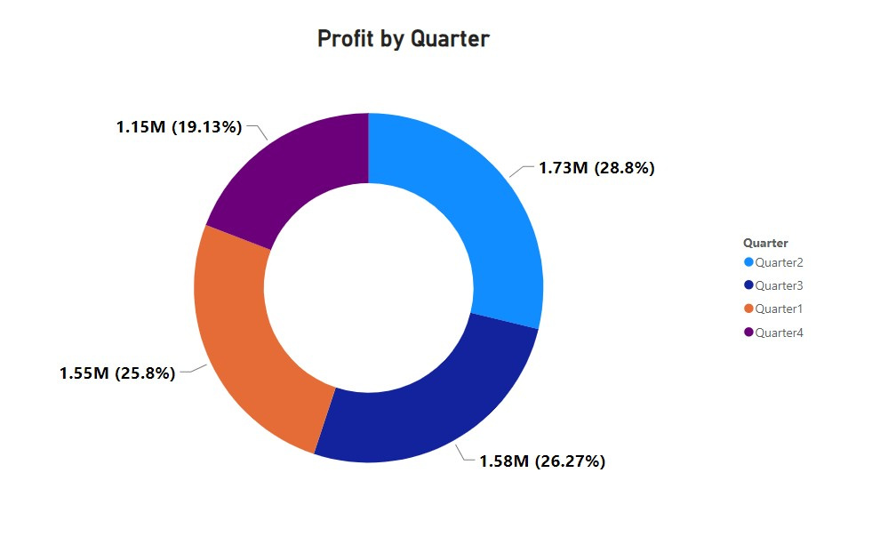
Kpi-11 yearly quarter sales
Quarterly Performance Variance Analysis helps to analyze the variance in sales performance between quarters within the same year. Identify quarters that performed exceptionally well or poorly compared to others and investigate the reasons behind these variances.
By conducting a thorough analysis of the yearly quarter sales of Olist store from 2016 to 2018, stakeholders can gain valuable insights into the company's sales performance, identify areas for improvement, and make informed decisions to drive business growth.
Conclusion: In conclusion, the analysis of yearly quarter sales data provides valuable insights into the performance of Olist store over the three-year period. By leveraging these insights, Olist can make informed decisions, refine its business strategies, and drive sustainable growth in sales and profitability.

Slide 17
CONCLUSION
Concluding on the Olist database, it's evident that the platform offers significant value in consolidating and managing e-commerce data for businesses. Through its centralized system, Olist enables sellers to streamline their operations, manage orders efficiently, and gain insights into their performance.
Additionally, the database facilitates better decision-making through data-driven analytics and reporting tools, empowering sellers to optimize their strategies and improve customer experiences.
However, there may be areas for improvement, such as enhancing data security measures and providing more advanced features for sellers. Overall, Olist serves as a valuable asset for e-commerce businesses seeking to scale and succeed in a competitive market landscape.

Slide 18
Suggestion
1. Best-Selling Products: Identify the top-selling products and product categories based on sales volume or revenue. This insight can help in optimizing inventory management and marketing strategies.
2. Customer Lifetime Value: Calculate the lifetime value of customers based on their purchasing behavior, frequency of purchases, and average order value. This insight can guide customer acquisition and retention strategies.
3.Customer Segmentation: Segment customers based on demographics, purchase.
4. Seasonal Trends: Analyze seasonal variations in sales and product demand. Identify peak seasons or periods of high demand for specific products or categories, which can inform inventory planning and promotional activities.
5. Seller Performance: Evaluate the performance of sellers on the platform based on metrics such as customer ratings, order fulfillment times, and product quality. This insight can help in managing seller relationships and ensuring a positive customer experience

Slide 19
SUMMARY
The Olist store Ecommerce project aims to elevate the platform's capabilities, user experience, and market presence to drive growth and deliver value to both sellers and customers. By focusing on key objectives, implementing strategic initiatives, and leveraging data-driven insights, Olist is poised to solidify its position as a leading eCommerce platform in Brazil and beyond.

Slide 20
Insights
Orders
Product Categories
Reviews
According to data Ecommerce has 99,440 orders in total.
With about 89,940 orders being delivered, the company has a 90.44%delivery success rate
There are many product categories which have many different products.
The categories range from Clothes, Home appliances to computer Hardware.
The average product rating is 4.09 stars.
The product categories going as high as 4.67 stars and low as 2.5 stars.

Slide 21
THANK YOU

